Slide 1
FPGANES

Slide 2
Top level

Slide 4
Cycle Number | Blocks | Action
0 | Processor Control → Registers | Instruction Fetch
1 | Register → Decode | Classify instruction and addressing mode
1 | Decode → Processor Control | Init state machine
2-6 | Processor Control → Registers | Populate scratch registers based on addressing mode.
Last Cycle | Processor Control → ALU | Execute
Last Cycle | Processor Control → Registers | Instruction Fetch

Slide 5
Signal name | Signal Type | Source/Dest | Description
addr_sel | output | Registers | Selects the value that needs to be set on the address bus. Belongs to enum ADDR
ld_sel | output | Registers | Selects the register that will receive the value from Memory Bus. Belongs to enum LD
st_sel | output | Registers | Selects the register whose value will be placed on dout. Belongs to enum ST
pc_sel | output | Registers | Selects the value that the PC will take next cycle. Belongs to enum PC
sp_sel | output | Registers | Selects the value that the SP will take next cycle. Belongs to enum SP

Slide 6
Signal name | Signal Type | Source/Dest | Description
alu_sel | output | ALU | Selects the operation to be performed by the ALU in the current cycle. Belongs to enum DO_OP
dest_sel | output | Registers | Selects the register that receives the value from ALU output.Belongs to enum DEST
src1_sel | output | ALU | Selects src1 for ALU. Belongs to enum SRC1
src2_sel | output | ALU | Selects src2 for ALU. Belongs to enum SRC2

Slide 7
Instruction_type=ARITHMETIC, addressing mode= IMMEDIATE
state=0 | state=1 | state=2
ld_sel=LD_INSTR; //instr= memory_data pc_sel=INC_PC; //pc++ next_state=state+1’b1 | ld_sel=LD_IMM; //imm=memory_data pc_sel=INC_PC next_state=state+1’b1 | alu_ctrl=DO_OP_ADC // execute src1_sel=SRC1_A src2_sel=SRC2_IMM dest_sel=DEST_A ld_sel=LD_INSTR//fetch next instruction pc_sel=INC_PC next_state=1’b1

Slide 8
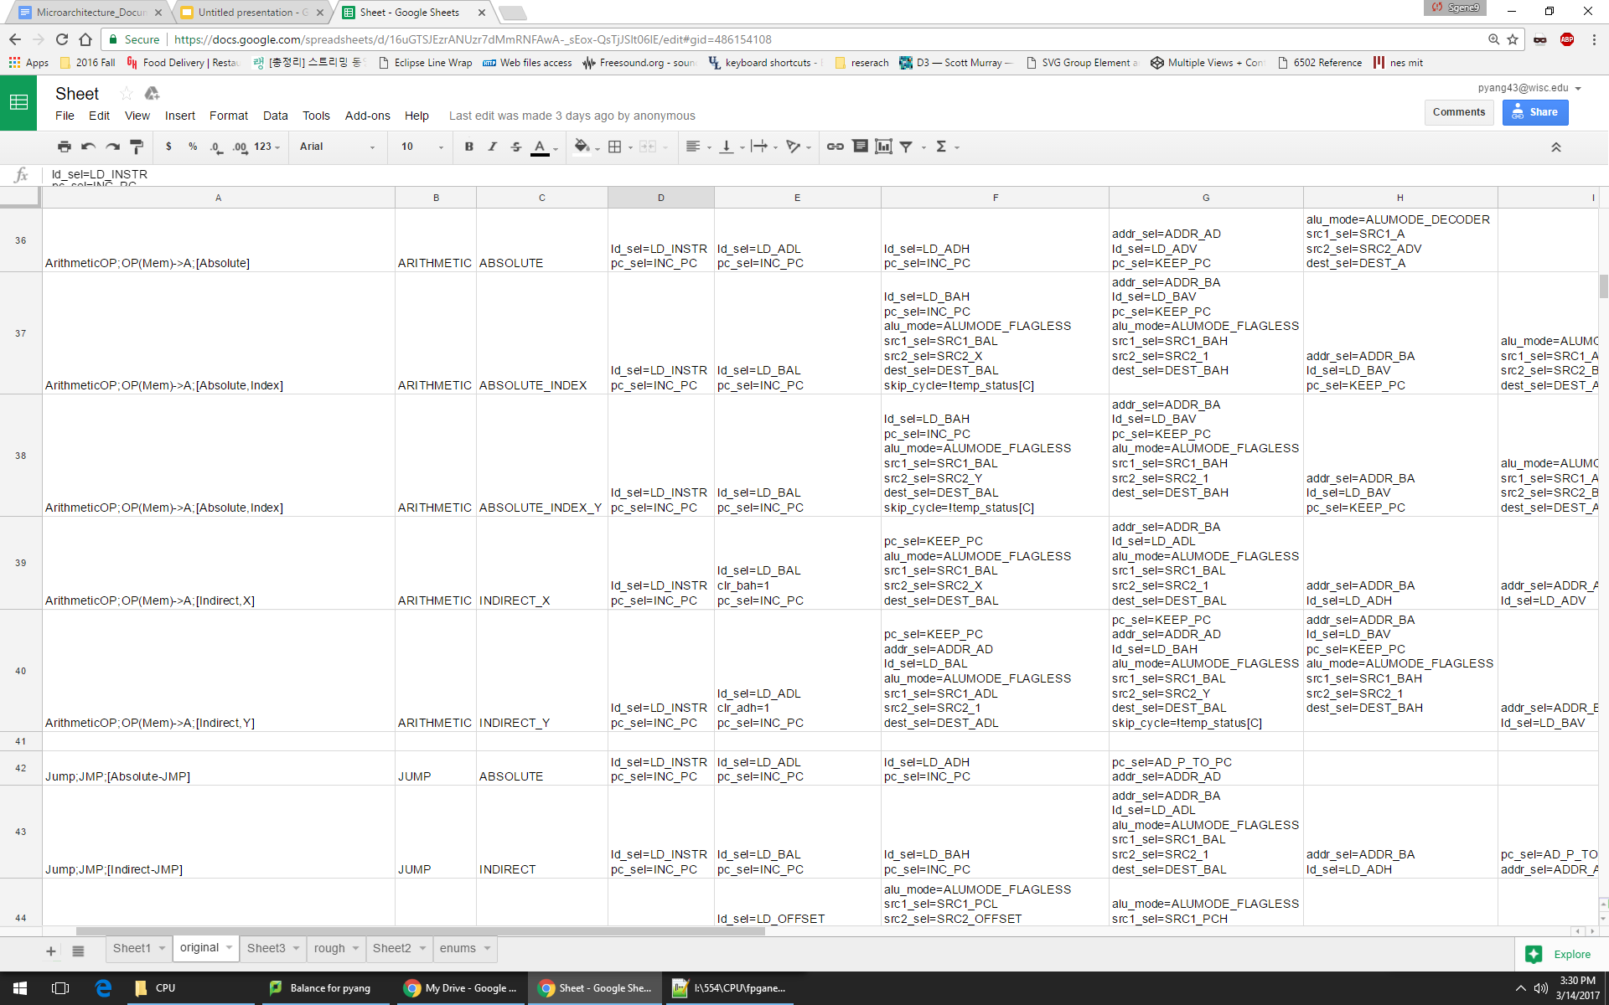

Slide 11
Background Renderer
The background renderer is really just a big old state machine.
The background renderer knows what scanline it is on and what pixel it is on. Since it is only active for a set number of those cycles it knows when it can do VRAM access.
Background Renderer is active on scanlines -1 - 239 for cycles (1-256 ) and (321-226)
The -1 scanline is a dummy line to just load the first two tiles of the background for the next scanline.
Each background tile for a scanline takes 4 VRAM reads and each read takes 2 cycles.
So when we have drawn one tile we load the spare into the current one we are drawing and the tile that was just read into spare.

Slide 12
Sprite Renderer
When the background renderer is not busy reading data for the current scanline the sprite renderer is taking VRAM cycles.
So for cycles (257-320) the Sprite Renderer is reading tile data from VRAM for the sprites on the next scanline.
When it is not reading values from VRAM it is reading data from OAM to determine what sprites should be drawn on the next scanline.

Slide 13
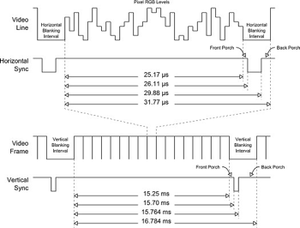
VGA
The VGA will receive in pixel data from the PPU at the clock speed of the PPU; however, we must write data to the VGA at 25MHz. Thus, our VGA block will have a small RAM block that gets updated by the PPU at it’s clock speed and read out to the VGA at the VGA clock speed.

Slide 14
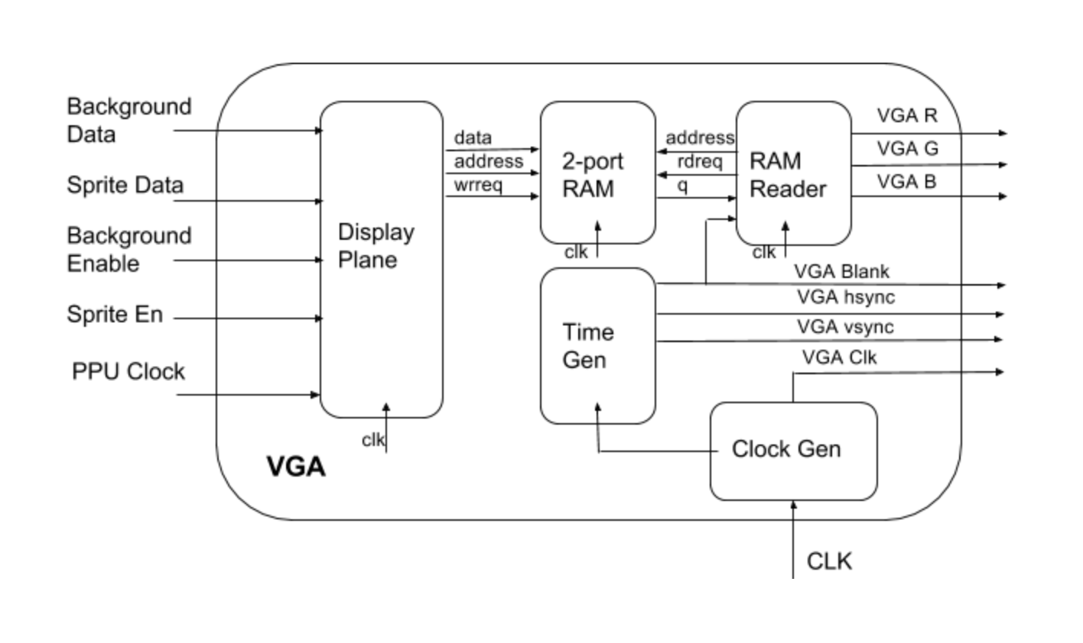
VGA Block Diagram

Slide 15
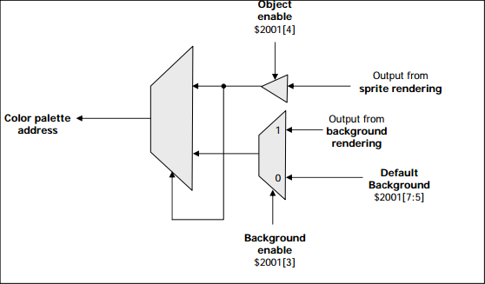
VGA Display Plane
Receives background pixel data and sprite pixel data
Uses two enable signals (for background and sprite) to determine which pixel has priority
This pixel will be written to the RAM block

Slide 16
VGA RAM Reader
The RAM Reader will update the VGA RGB values every time the Blank signal is high
The NES outputs the pixels as one 8-bit value. The RAM reader will convert these 8-bit values into 3 separate 8-bit values for R, G, and B
The RAM Reader is also responsible for adding black borders to the edge of the screen which will make the resolution work for the VGA
It will also scale the image to a higher resolution by multiplying the pixels

Slide 17
Controller
Instead of using a NES controller we will be interfacing with a keyboard via SPART
The controller will detect writes to bit 0 of address $4016, which will update the button values and store them into a register
Once the button states have been updated, they can be serially read from $4016 bit 0 for player 1 and $4017 bit 0 for player 2
These will be read as 1 for pressed and 0 for not pressed in the order A, B, Select, Start, Up, Down, Left, Right
Any reads after the first 8 will return 0

Slide 18
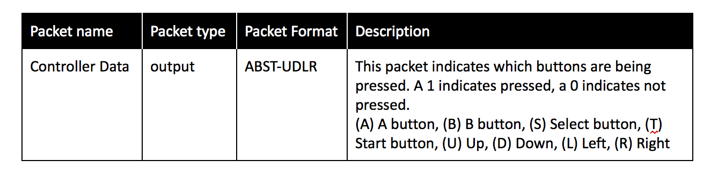
Controller Simulator
We will write a controller simulator Java program that will communicate with the FPGA over SPART
We will use a keylistener to determine when the keys are pressed and released
Each time a key state is updated we will send a packet via the SPART interface.

